Slide 1
Microsoft 365 & Power Platform Development – Bi-weekly call
Your host in this call: David Warner (Microsoft)
April 28th, 2022

Slide 2





v
Agenda
Latest on PnP Framework and Core SDK extension
Latest on PnP PowerShell
Latest on yo Teams
Latest on Microsoft Graph Toolkit
Latest Microsoft Teams samples
Latest on Power Platform samples
Picture time with the Together Mode!
Natalie Pienkowska & Roy Paar - Updates on Independent Publisher Connectors & GitLab Connector Demo
André Lage - List formatting magic - Discussion board formatting
Thomas Gölles - TeamsFx .Net - Teams Explorer Sample

Slide 3
Opportunities to Participate in the community
Demo solution or technical pattern
Contribute on GitHub
Provide feedback
Great opportunity to get visibility for you or your company. Demo sample or explain how you extend or customize SharePoint Online with live demo in your projects. Reach out to team for volunteering.
Request a demo spot on the call
https://aka.ms/m365pnp/request/demo

Slide 4
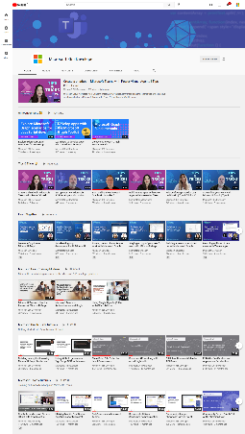
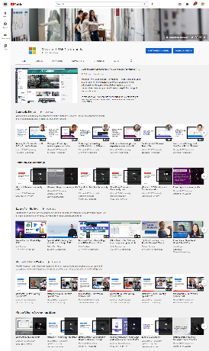
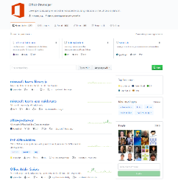
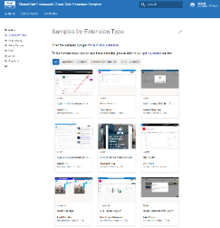
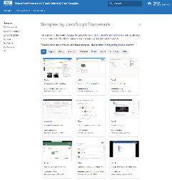
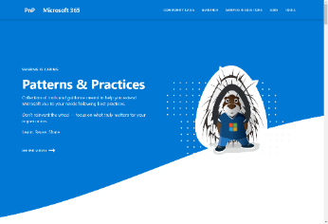
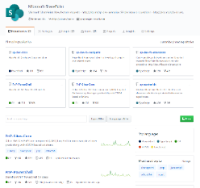
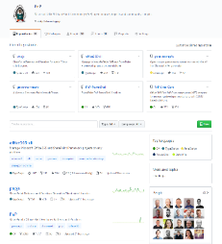
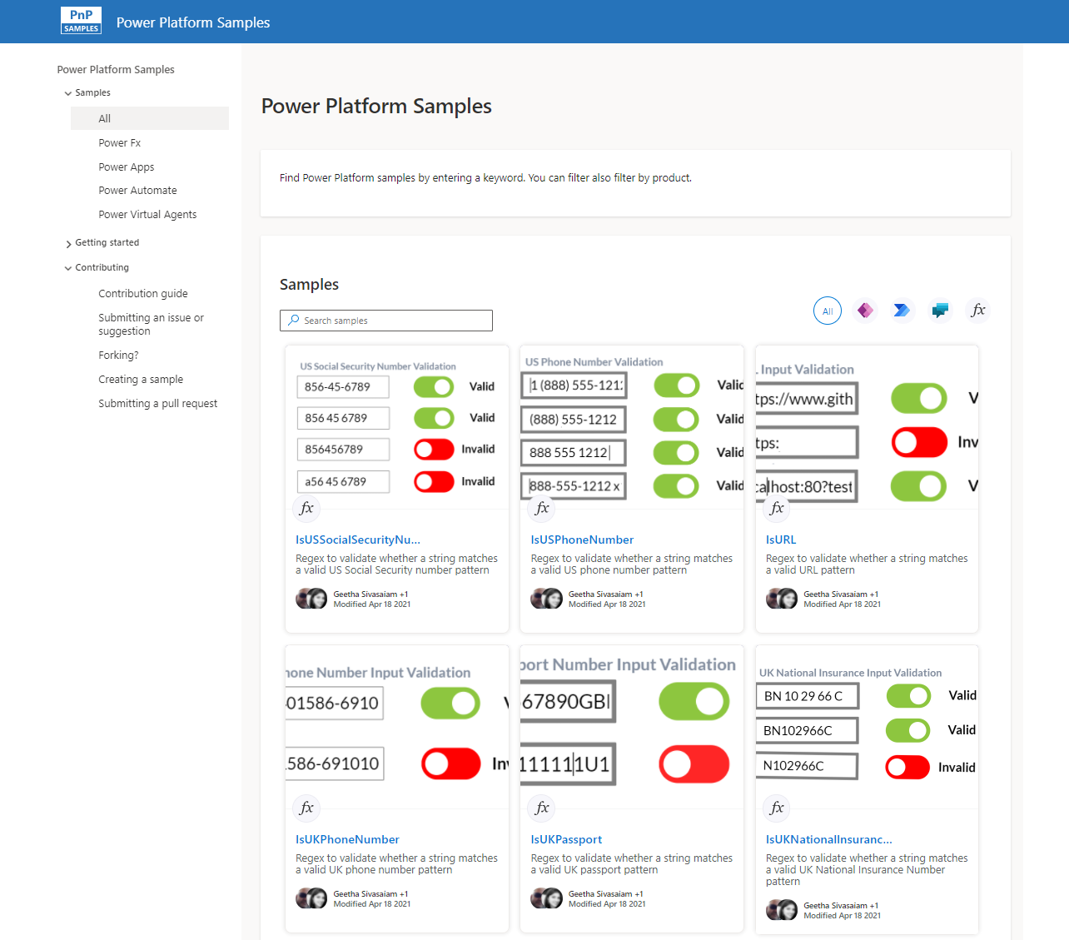
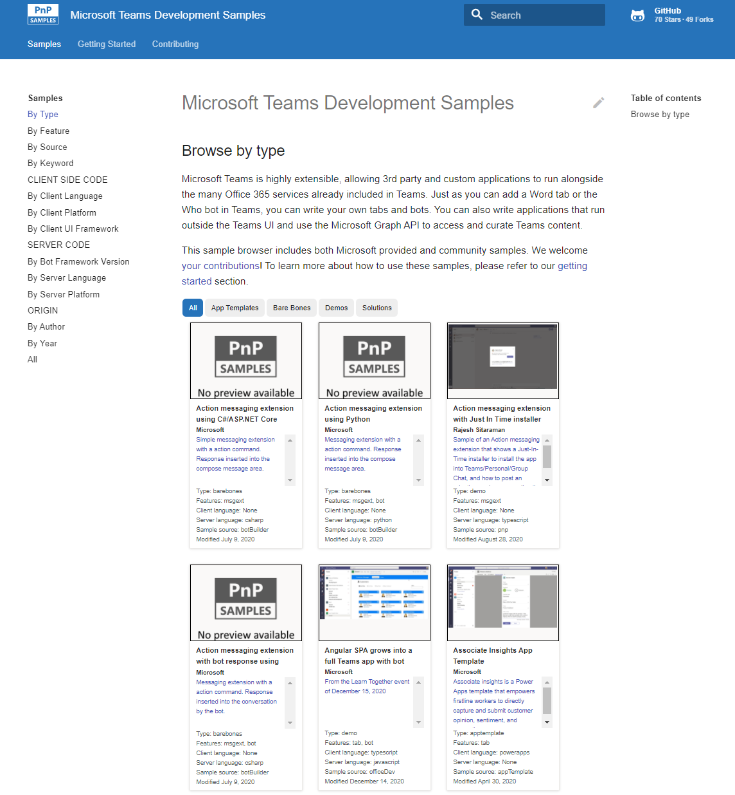
Microsoft 365 developer videos
Microsoft 365 community videos
Open-source
Sample galleries
Open-source initiatives and samples
github.com/sharepoint
github.com/pnp
github.com/officedev
github.com/microsoftgraph
aka.ms/teams-samples
aka.ms/spfx-webparts
aka.ms/powerplatform-samples
aka.ms/spfx-extensions
aka.ms/list-formatting
aka.ms/m365pnp
aka.ms/m365devyoutube
aka.ms/m365pnp/videos
@Microsoft365Dev | @m365pnp

Slide 5
Microsoft 365 developer community calls
Microsoft 365 platform (weekly) https://aka.ms/m365-dev-call
(Notice. This call is on a summer break between July 1st and 31st of August 2022)
Adaptive Cards https://aka.ms/adaptivecardscommunitycall
Microsoft identity platform https://aka.ms/IDDevCommunityCalendar
Office Add-ins https://aka.ms/officeaddinscommunitycall
Power Platform https://aka.ms/PowerPlatformMonthlyCall
Microsoft 365 & Power Platform Development (bi-weekly) https://aka.ms/m365-dev-sig
Viva Connections & SharePoint Framework (bi-weekly) https://aka.ms/spdev-spfx-call
Download recurrent invites from
https://aka.ms/m365/calls
Notes:
m365-dev-sig

Slide 6
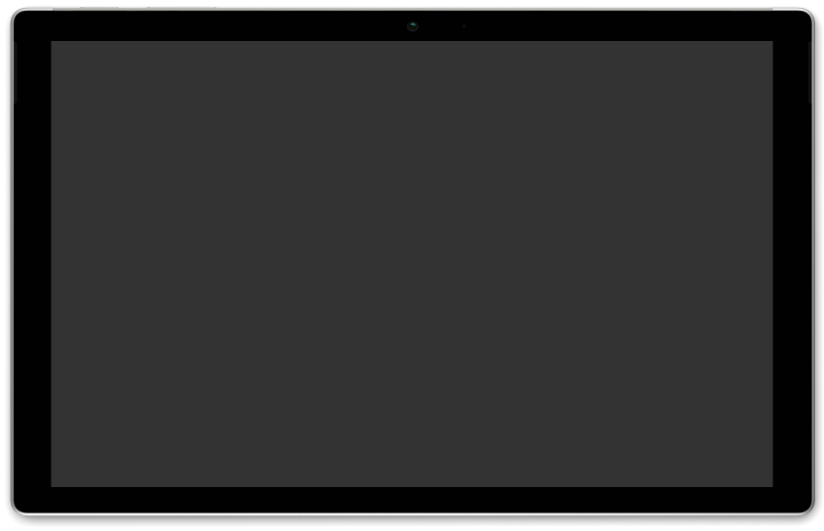
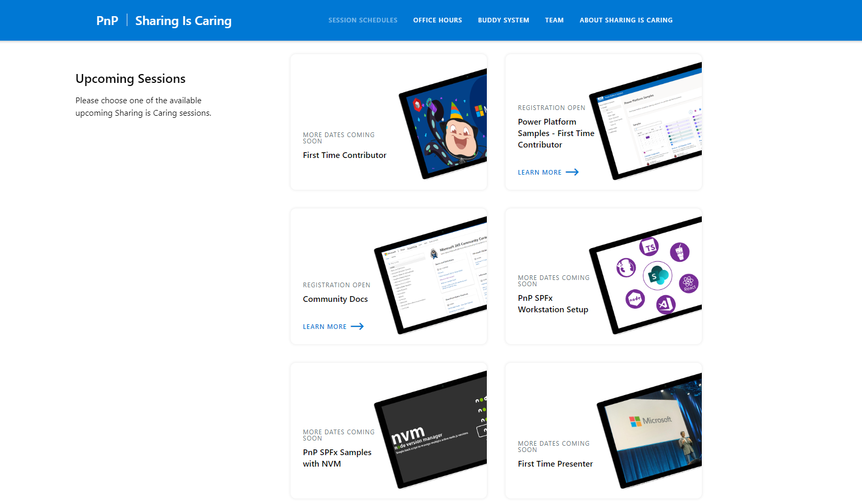
GUIDANCE
Learn how to get started in the open-source PnP community!
Upcoming Sessions:
First-time contributor
Power Platform Samples – First Time Contributor
Community Content Docs
SPFx Developer Workstation Setup
Using PnP SPFx samples w/ NVM
More than code with VS Code
First-time presenter
M365 Maturity Model Practitioners
https://aka.ms/sharing-is-caring
Notes:
25 Total attendees, 16 attendees who attended both First-Time Contributors and Community Docs sessions.

Slide 7
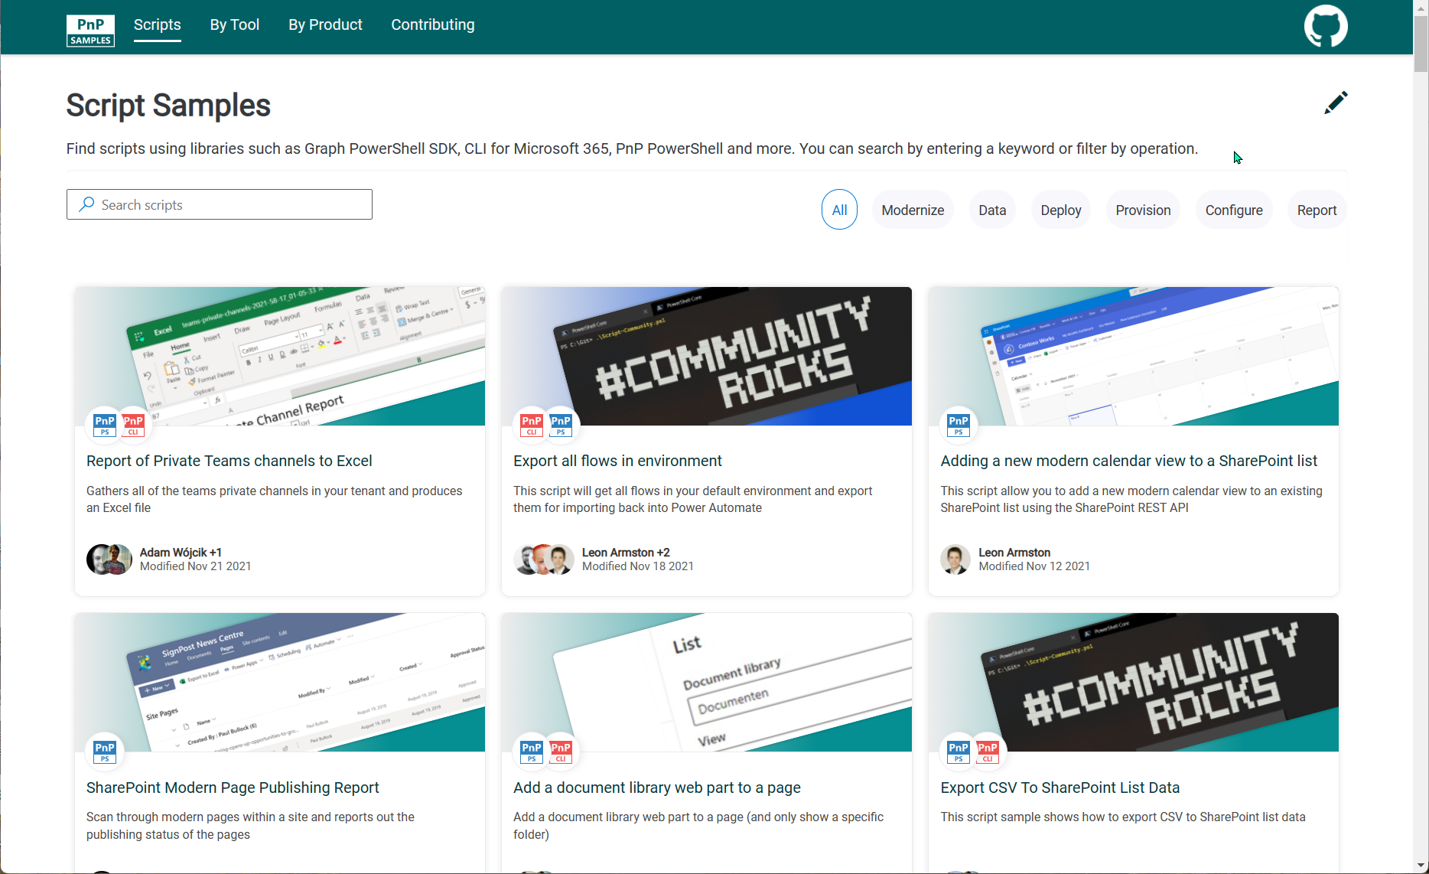
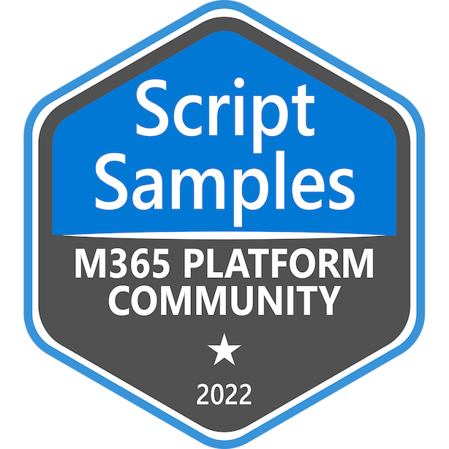

SCRIPT SAMPLES
One centralized location for all scripts for helping your day-to-day life. Contribution's welcome!
Site now has 149 scenarios and 212 scripts, using Microsoft Graph, CLI for Microsoft 365, PnP PowerShell, SPO Management Shell tooling, Power Apps PowerShell, Azure CLI, and more…😁 AND samples integrated into "Unified" Solution Gallery 🤩
Samples Include
New Scenarios
Get Hub Sites Details and Export it to CSV (Chandani Prajapati)
Export OneDrive Admins (Matt Maher)
Updates or scenarios implemented with alterative tools
Get Hub Sites Details and Export it to CSV – Two additional tool updates (Jasey Waegebaert & Chandani Prajapati)
List Guests within Teams in a tenant (Jasey Waegebaert)
Export a csv report on all Whiteboards (Nanddeep Nachan)
Thank you for your samples and contributions! 👏
Please reach out if you need support with submissions
or if you feel something can be improved!
200+ SCRIPTS
THANK YOU!
aka.ms/script-samples

Slide 8





COMMUNITY
PnP Recognition Program
Showcasing your contributions
Powered by Credly
More achievement levels coming soon
https://aka.ms/m365pnp-recognition
Notes:
25 Total attendees, 16 attendees who attended both First-Time Contributors and Community Docs sessions.

Slide 9





Latest news from Microsoft engineering on Microsoft 365 topics
Community together mode group photo
Erin Bailie - Extend your Microsoft Teams app to Outlook and Office
James Eccles & Bert Jansen - Introducing new M365 Assessment Tool with SharePoint Syntex Module
Nancy Wang - Run Office Scripts with a button - now in Excel for Windows
AGENDA
Microsoft 365 platform call 3rd of May @ 8 AM PT
Weekly call with Microsoft presenters covering the latest Microsoft 365 platform updates
Download recurrent invite from https://aka.ms/m365-dev-call
Notes:
Dan’s slide

Slide 10
PnP .NET libraries A set of libraries that helps Microsoft 365 .NET developers to be more productive when working with SharePoint and Teams

Slide 11
UPDATE
NEW:
Admin library GA: enumerate and manage sites + sub sites, manage apps, manage tenant settings, multi-geo support and much more
Site branding support
Support for using Search
Viva Connections dashboard editing
Throttling notifications
PnP Core SDK 1.6.0 release 🎉
aka.ms/pnp/coresdk
Update needed

Slide 12
UPDATE
Various improvements and fixes in the provisioning engine, extension methods and page transformation
PnP Framework 1.9.0 release 🎉
aka.ms/pnp/framework
Update needed

Slide 13
UPDATE
Supporting adoption and deprecation scenarios
Will replace the Modernization Scanner overtime
Initial module: SharePoint Syntex Assessment
Microsoft 365 Assessment tool 1.0.0 release 🎉
aka.ms/microsoft365assessment

Slide 14
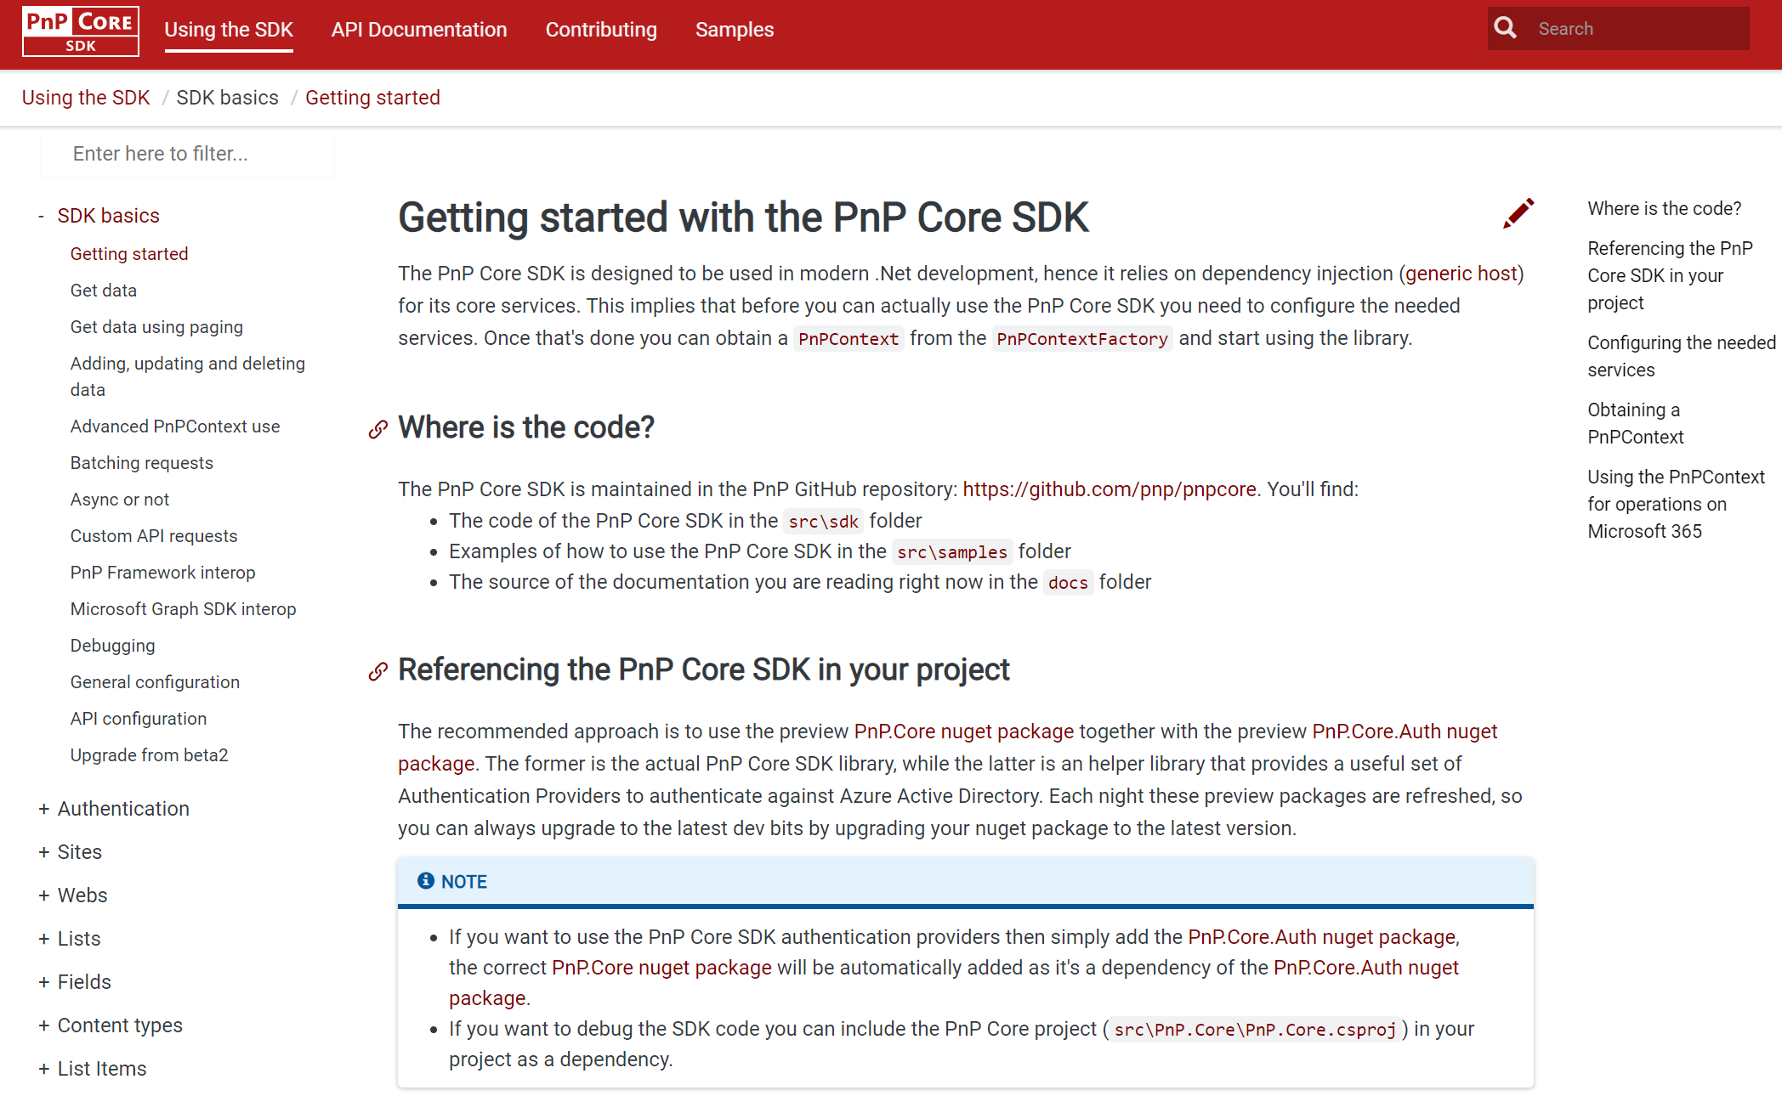
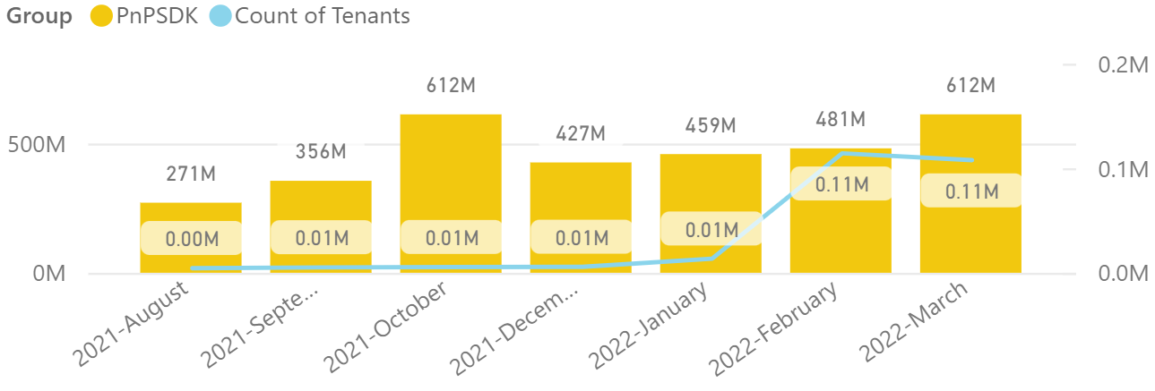
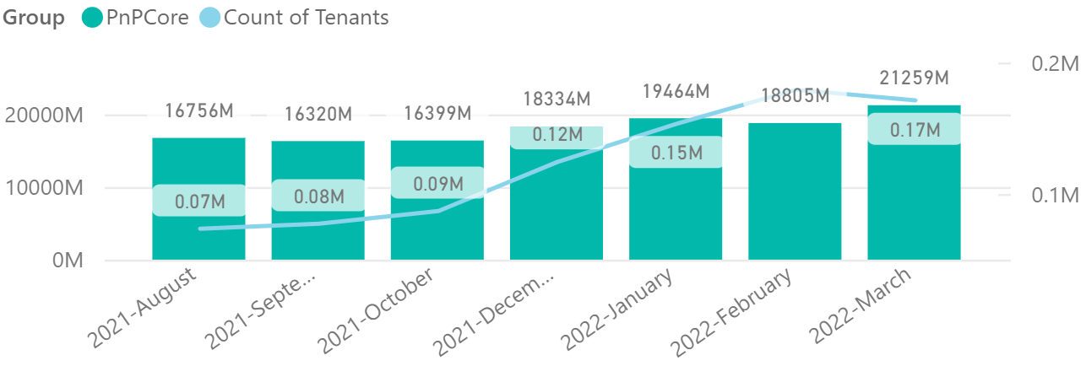

PnP .NET libraries
PnP Framework
PnP Core SDK
489,000 downloads!
Version 1.9.0 released!
Prepping 1.10.0:
Merge pending PRs
General fixes and improvements: 👍 Koen Zomers, Sergei Sergeev
669,000 downloads!
Version 1.6.0 released!
Prepping for 1.7.0:
Navigation support, Team tab channel creation improvements, file & listitem copy/move functionality using CopyJobs API and Teams Chat support : Mathijs Verbeeck 👍💪🚀
Fixes and improvements: cleaning up bug list and discussions…👍 Dennis van Niel, Sergei Sergeev, Koen Zomers and Bert Jansen
>180.000 tenants!
Working on it
https://github.com/pnp/pnpcore/blob/dev/src/sdk/CHANGELOG.md
Roadmap
nuget.org/profiles/pnp
nuget.org/profiles/pnp
aka.ms/pnp/framework
aka.ms/pnp/coresdk

Slide 15
PnP PowerShell Open-source cmdlets which provide you an easy way to manage your SharePoint and Teams environment.

Slide 16
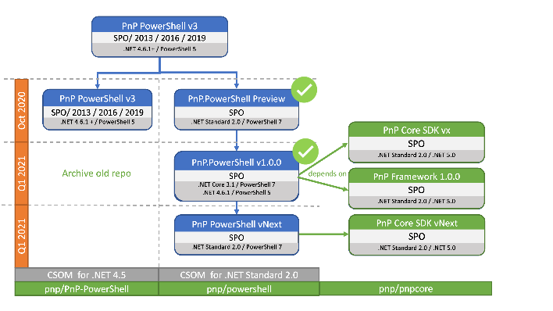
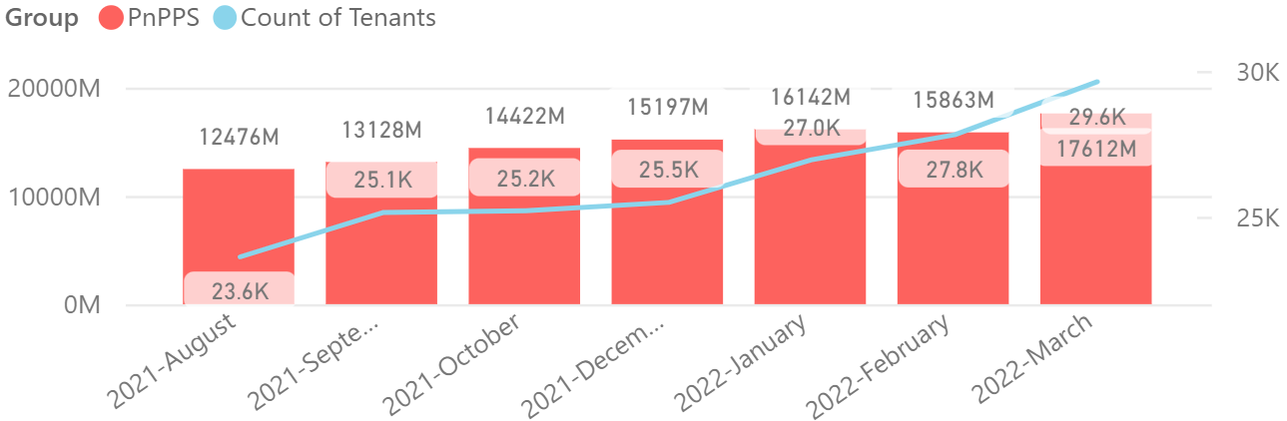

PnP PowerShell
Cross Platform PnP PowerShell
V1.10.0 released!
Many updates and fixes!
1.6 million downloads!
100 million cmdlets executed per day!!
Docs shifted, no more docs.microsoft.com
Documentation, Articles and tips available at https://pnp.github.io/powershell
PnP PS runs in PS 5, PS 7, Azure CloudShell, Azure Functions, Azure Runbooks & Raspberry Pi
Bug Fixes
More Autocomplete additions to the cmdlets
Added Add-PnPTeamsChannelUser for adding owners/members to a private channel in a team
Added ResourceBehaviorOptions to New-PnPMicrosoft365Group cmdlet
New blogpost covering the 1.10 release : https://pnp.github.io/blog/pnp-powershell/pnp-powershell-v1-10/
>29.500 tenants!
Working on it
https://github.com/pnp/powershell/blob/dev/CHANGELOG.md
github.com/pnp/powershell
www.powershellgallery.com
PnP.PowerShell

Slide 17
yo teams Open-source Yeoman generator for Microsoft Teams development

Slide 18
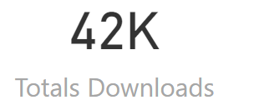
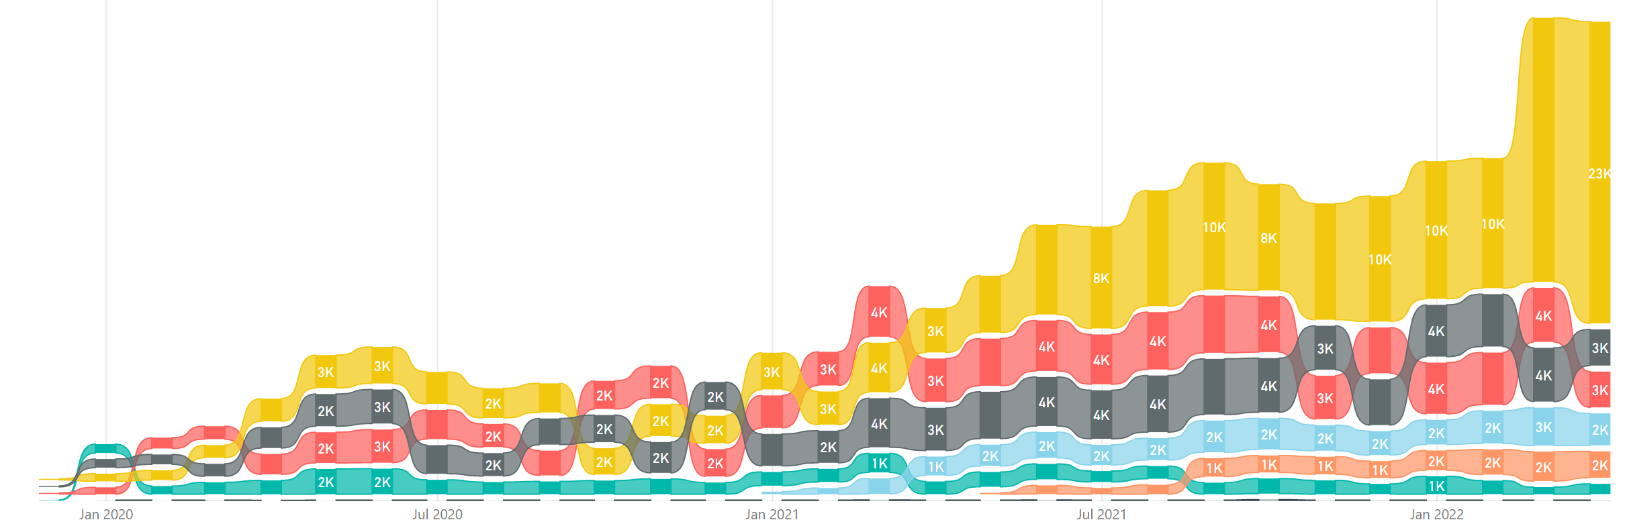
yo teams
https://aka.ms/yoteams
generator-teams – The Teams apps generator
📃 Docs published at https://pnp.github.io/generator-teams/
🚀 Latest release: 3.5.0 [2021-11-18]
Improved telemetry (https://pnp.github.io/generator-teams/about/telemetry/) Brand new template used for bot scaffolding – better aligned with Bot Fx code samples
🔮 Preview: n/a []
Documentation updates
🧪 Next: 4.0.0-next(.2) [2011-12-17]
Using @microsoft/teams-js version 2.0 (promise based) Support for the m365DevPreview manifest Allows you to build Tabs for Outlook and Office.com
📅 Roadmap:
Azure AD App creation via M365 CLI Meeting extensions HTTPS support for local server (thanks @paolopia) – PR created Deprecate some scaffolding options –potential targets: calling bots, localization, viva connections tab (Deprecation of scaffolding options for v4 · Discussion #304 · pnp/generator-teams (github.com)) Documentation and integration of how to use MGT components, in collaboration with Seb L. (#279)
4.0.0 planned for mid-May 🚀
Preview in the next few weeks to include
New @microsoft/teams-js SDK v 2.0
Deprecation of a few unused features
yoteams-build-core
yoteams-deploy
🚀 Latest release: 1.6.0 [2022-02-17]
PR #278, from Paul Schaeflein, with additional gulp-inject options Support for schema m365DevPreview and 1.12
🔮 Preview: n/a 🧪 Next: 1.6.0-next.1 [2021-12-17]
Support for the m365DevPreview manifest 📅 Roadmap:
🚀 Latest release: 1.1.0 [2021-11-18]
Telemetry for tasks
🔮 Preview: n/a
📅 Roadmap:
Automatic updates of bot endpoints and Tab App ID URI for ngrok/Codespaces integrations

Slide 19
Microsoft Graph Toolkit Web Components powered by Microsoft Graph

Slide 20

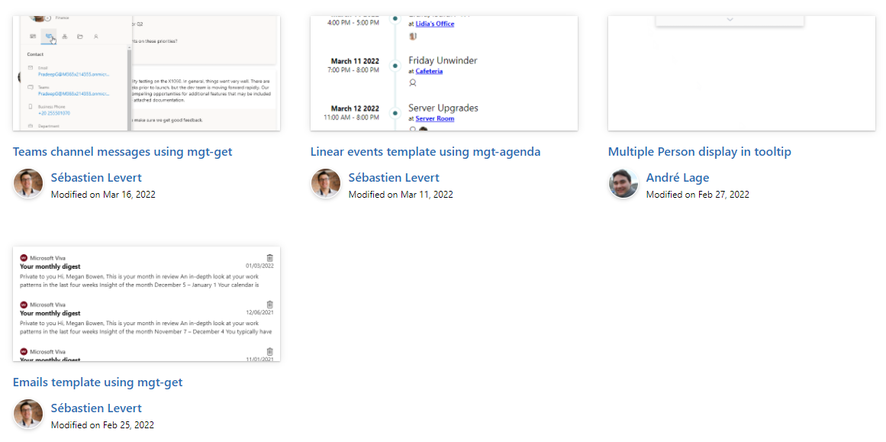

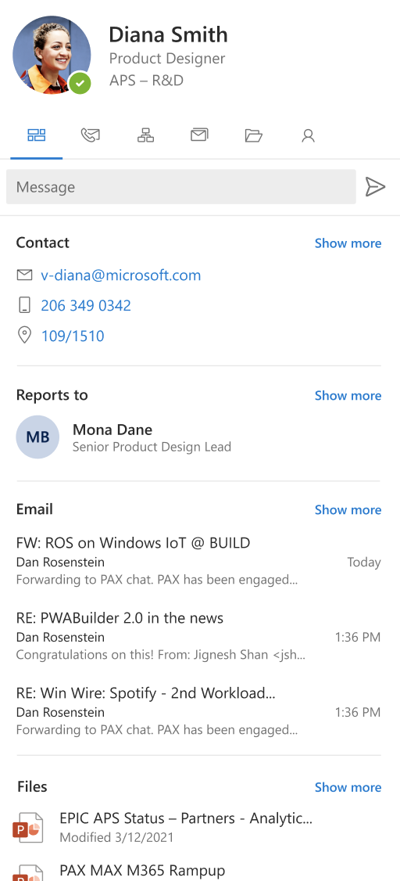
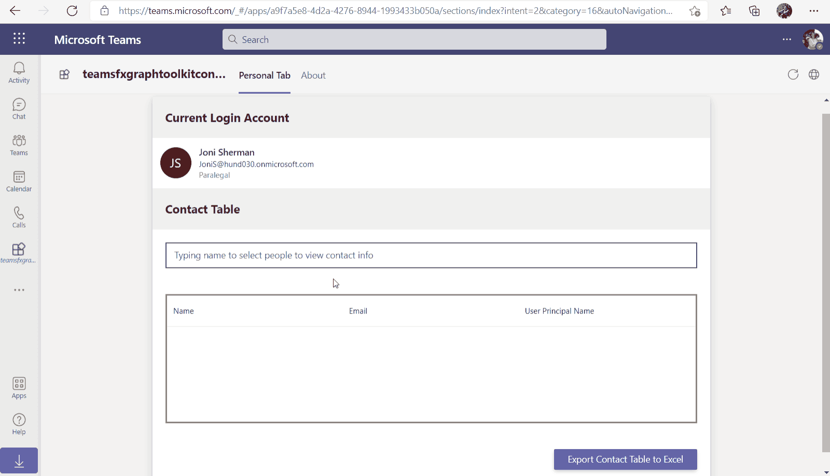
Microsoft Graph Toolkit
👀 More information: aka.ms/mgt
What’s new 🎉
The MGT samples repository is now LIVE! https://aka.ms/mgt/samples
v2.4.0 was released! Update your packages! https://aka.ms/mgt/v2.4.0
Updates to our mgt-file, mgt-people-picker and mgt-person components and our mgt-teams-msal2-provider!
Thanks @NathZ1 and @PaulMcManus23 for your contributions 🎉
We have a preview release for our TeamsFxProvider!
npm i @microsoft/mgt@next.teamsfx
Our playground is now a PWA! Have a look https://aka.ms/mgt/dev
What's next? 💻
Aligning all Toolkit components to Fluent UI Web Components
Msal2 and Teams providers improvements!
We need your help ❤️
🐞 Help us fix bugs
🆕 Help us build/improve features
help-wanted & good-first-issue -> https://aka.ms/mgt/issues

Slide 21


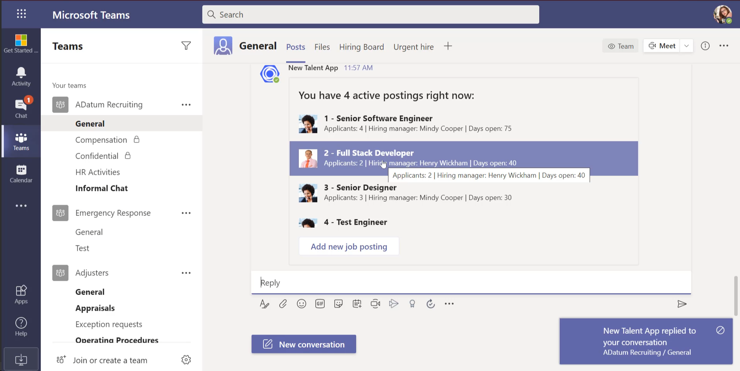


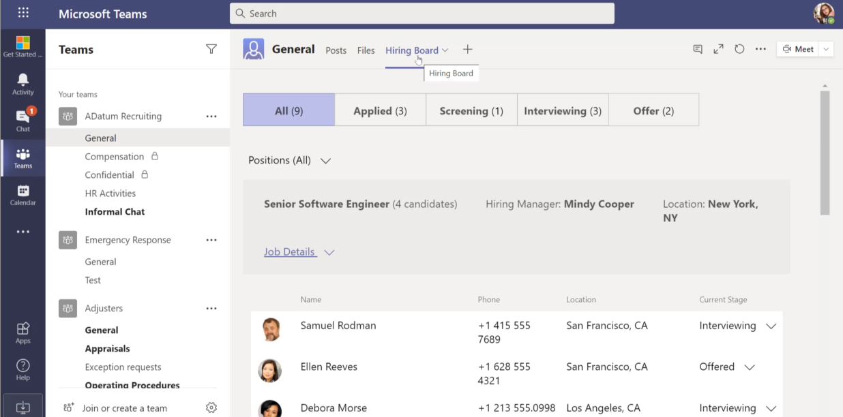

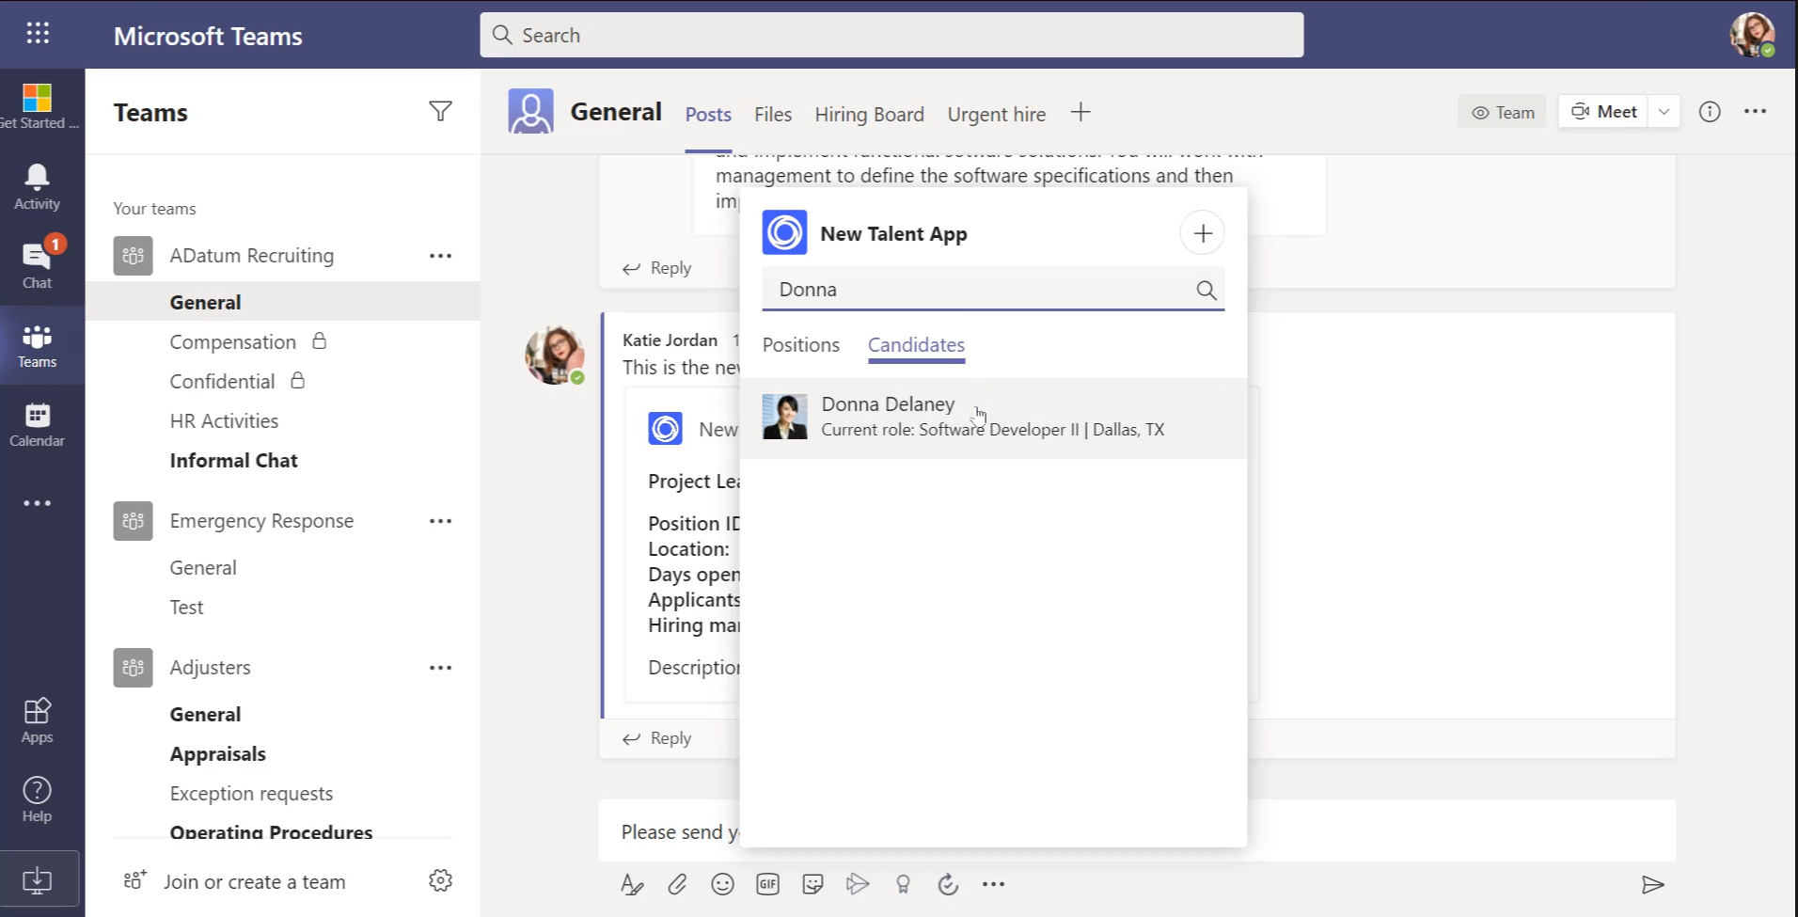





Microsoft Teams Samples
Now in Node/Typescript!
HR Talent App sample and tutorial
Try the sample: https://aka.ms/hr-talent-app-node
Got a cool Teams app to share?
Please contribute – or make use of the samples yourself!
https://aka.ms/teams-samples
Scott Perham
SAMPLES WANTED!
Jack Lewis
Thank You Community
Notes:
Wajeed Shaikh – Teams PM

Slide 22
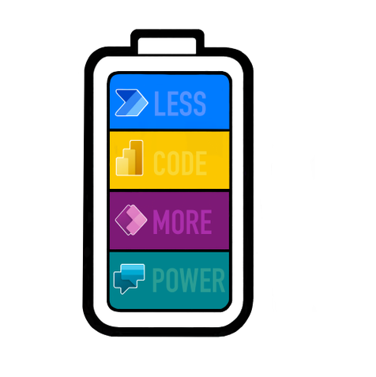
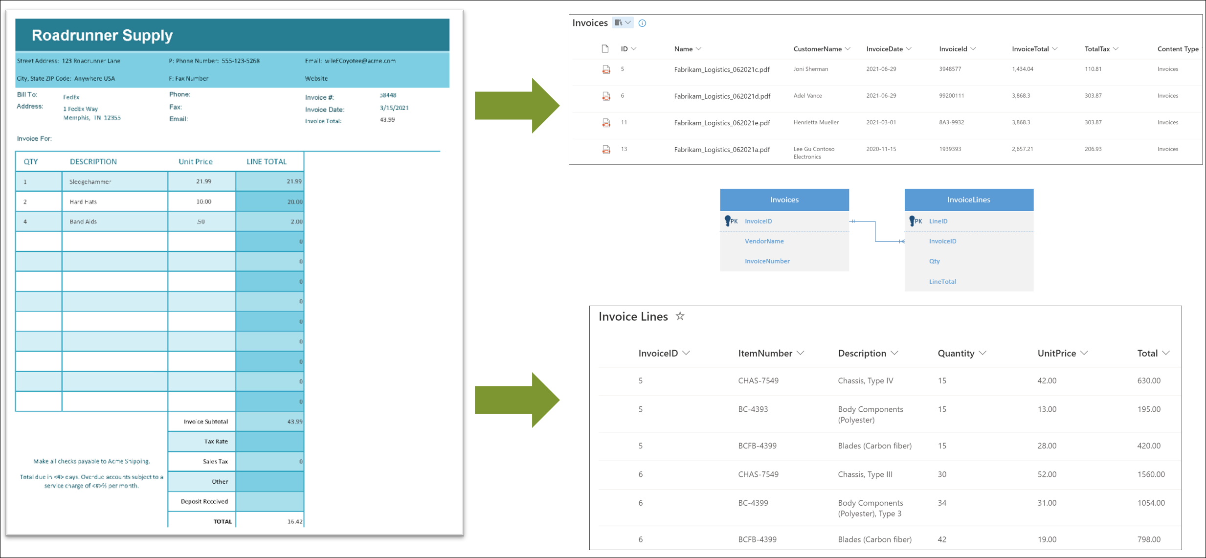


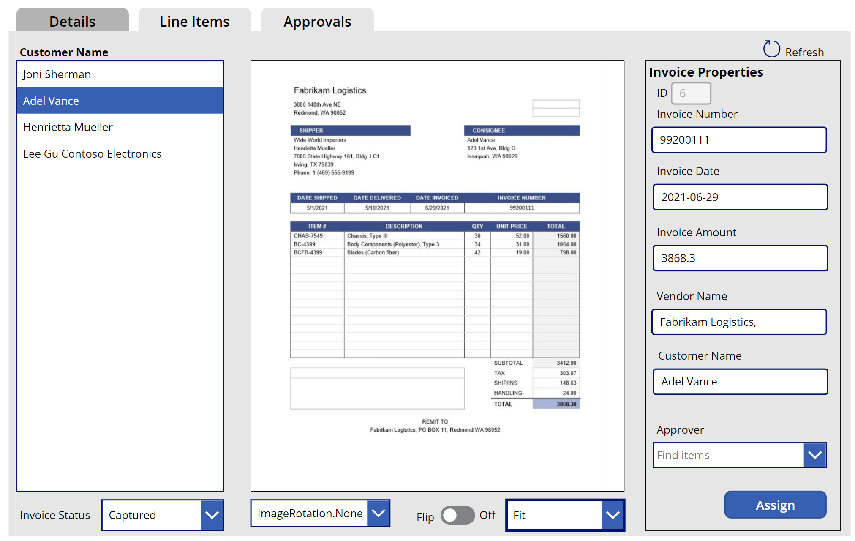
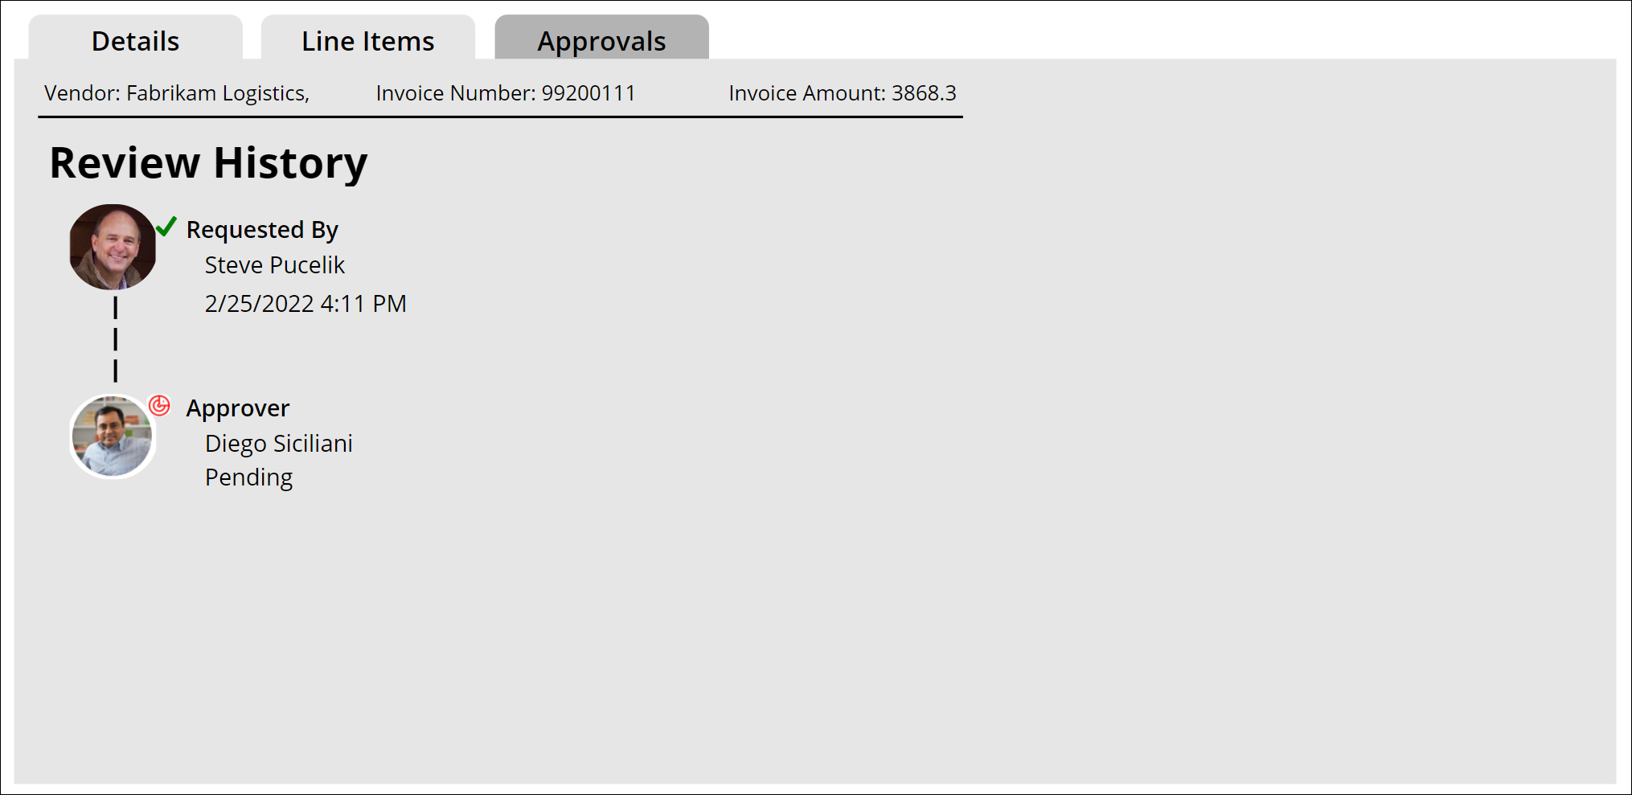
Power Platform Samples
New:
Invoice Automation using the SharePoint Syntex Steve Pucelik | Spucelik
Update needed
Join the Power Platform Contributors
Sharing is Caring Session – May 9th
aka.ms/powerplatform-samples ​
Notes:
These are the updates that we processed since out last call.
New samples:
- Power Automate: SharePoint Collect Feedback April Dunnam | @aprildunnam Demonstrates:
Executing a Flow from a SharePoint Library with input parameters
Leveraging the custom responses option in Power Automate approvals
https://github.com/pnp/powerautomate-samples/tree/main/samples/sharepoint-collect-feedback
- Power Automate: Get Graph API Data within Power BI Reports Scott McKenzie | @365EDUBI Enables Graph API data to be refreshed within the Power BI Service. https://github.com/pnp/powerautomate-samples/tree/main/samples/graph_api_in_power_bi
Updated samples:
Power App: Fluent UI Custom Theme Fabio Franzini | @franzinifabio Fixed datepicker control theme https://github.com/pnp/powerapps-samples/tree/main/samples/fluentui-custom-theme
These latest samples should show within 24 hours

Slide 23
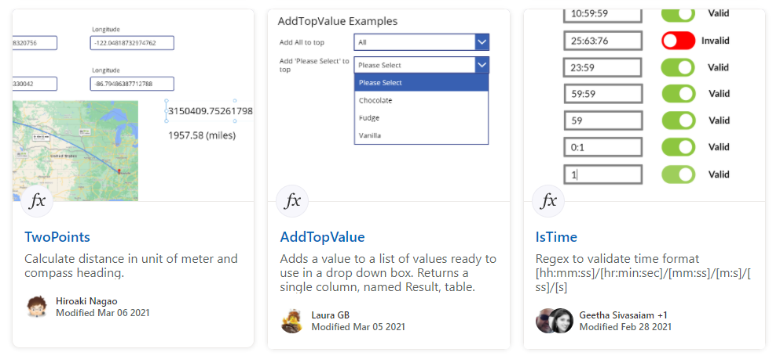
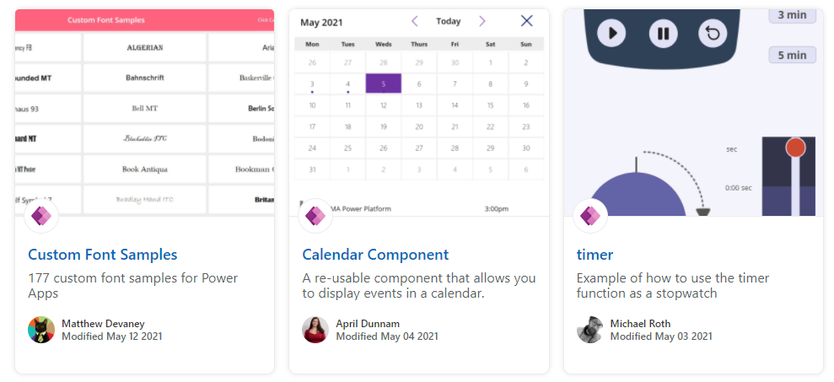
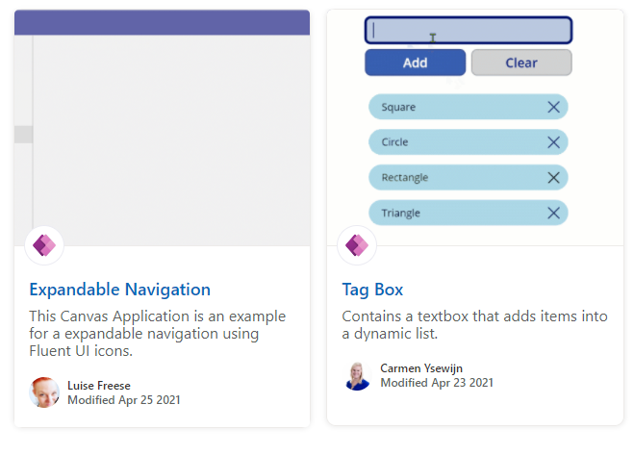
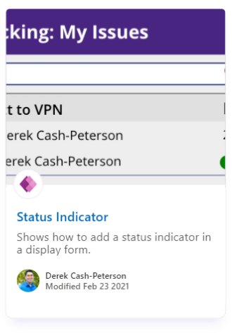
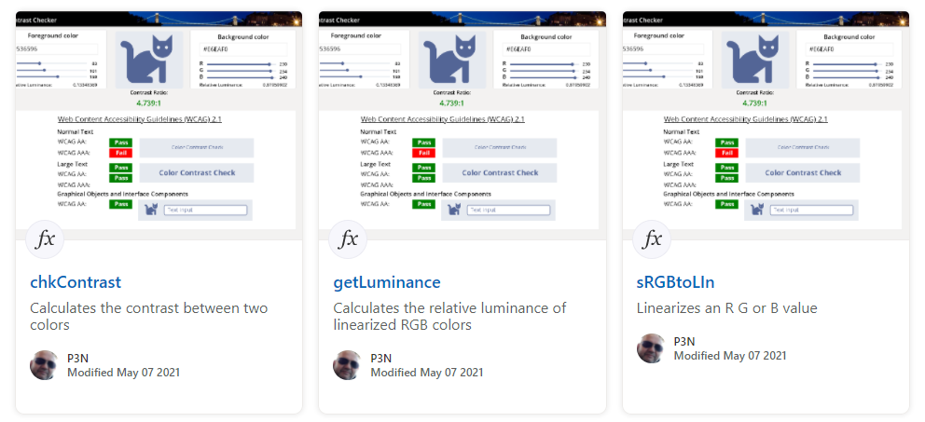
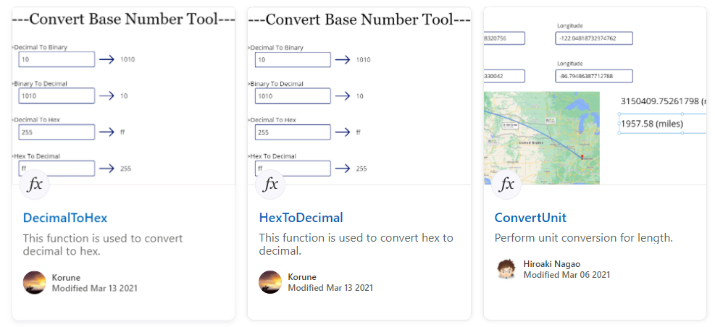
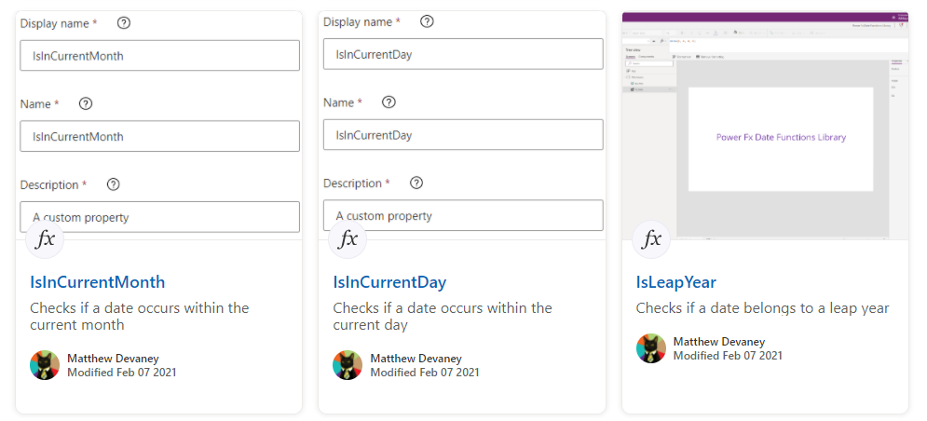
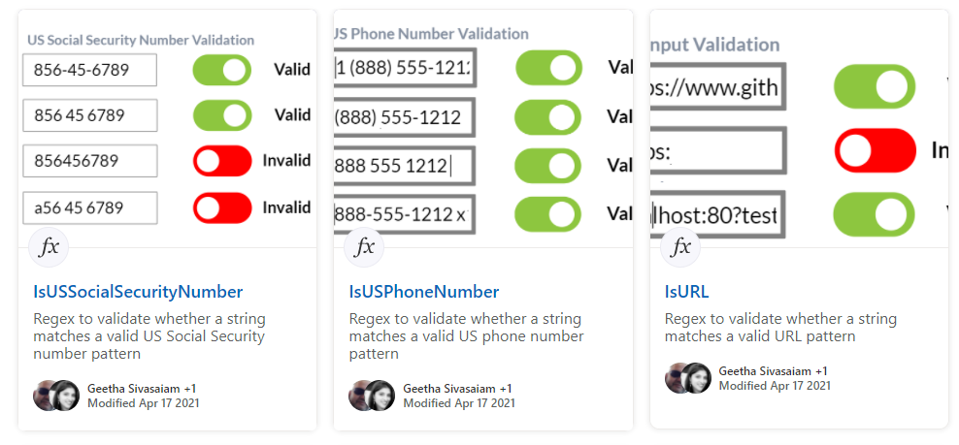
Power Platform Samples
aka.ms/powerplatform-samples ​
Power Apps templates​
Power Apps components​
Power Apps connectors​
Power Fx Custom Functions
Power Automate flow templates​​
PowerBI​​
Power Virtual Agents​​
Join the Power Platform Contributors
Sharing is Caring Session – May 9th

Slide 24


Optional picture time!
Video on and we’ll grab a Together Mode pic with those who are willing to do this.
We are together on this as a community!
By enabling your camera for the picture, you’ll give us the permission to share your picture in social media.

Slide 25
DEMO
Updates on Independent Publisher Connectors & GitLab Connector Demo
– Natalie Pienkowska
– Roy Paar
List formatting magic - Discussion board formatting
– André Lage
TeamsFx .Net - Teams Explorer Samples
– Thomas Gölles

Slide 26

Q&A

Slide 27
Thank you
Recording will be available in 24 hours on
Microsoft 365 Community (PnP) YouTube channel
https://aka.ms/M365PnP/videos
(subscribe today)
Follow us on Twitter
@Microsoft365Dev | @M365PnP
Next M365 General Dev call: May 12th at 07:00am PT
Next Viva Connections & SharePoint Framework call: May 5th at 07:00am PT
See all other community calls from https://aka.ms/m365pnp

Slide 28



Slide 29
Thank you

